Slide 1

SLIDE DECKS SEE THE DIFFERENCE!

Slide 2
TWO IMPORTANT REMINDERS
Keep it SIMPLE
Focus on AUDIENCE

Slide 3
Data-Heavy Content vs. “Picture-Friendly” Content
For each of the following pairs of slides, compare/contrast the data-heavy slide with the revised slide that emphasizes the key point(s) in an easy-to-read, easy-to-understand format. Compare and contrast them.

Slide 4
According to a 2010 UEFA study detailing spending for European professional soccer, clubs' combined annual loss rose 36 percent from 2009-2010.

Slide 5
36%
$520 million

Slide 6
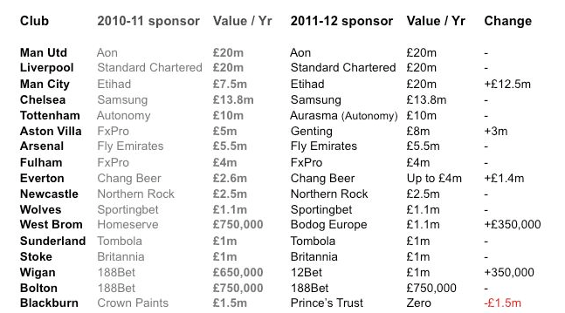
Premier League Sponsorship Deals Top 8 Teams for 2011-2012
sportingintelligence.com

Slide 7


Slide 8
LOGOS BY COLOR
Yellow = Optimism
Nikon, Subway, Best Buy, McDonald’s
Orange = Friendly
Nickelodeon, Firefox, Fanta, Amazon
Red = Excitement
Coca Cola, Target, Nintendo, Avis
Purple = Creativity
Taco Bell, Barbie, Hallmark, Welch’s
Blue = Trust
Lowe’s, Oreo, Dell, Oral-B
Green = Peaceful
John Deere, BP, Animal Planet, Whole Foods

Slide 9

Image courtesy of thelogocompany.net

Slide 11
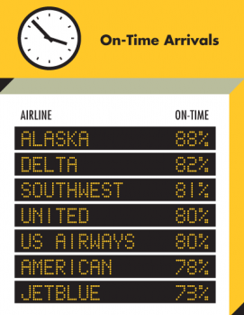
Image courtesy of huffingtonpost.com

